Slide 1
CS 440: Coding Project
Software in Support for Distributed Collaboration
Spring 2021: Group 4
Cloudgile

Slide 2
Overview of the project
This project is a cloud-based web platform which allows developers and managers to collaborate in an agile environment. The project uses Firebase as a REST API for authentication, authorization and management of a realtime database where all the user data is stored in JSON format and synchronized in realtime to every connected user. It uses React as its front end framework. Also, the project uses React to design and display various UI components and to store their local state.

Slide 3
Login and Firebase Authentication
New users can create a new account by Signing in from Google or by entering an id and password of their choice. This will create a new user under the users section in the Firebase Realtime Database.
Existing users can login through their Google account or by entering their id and password. In this case, the product will fetch the already existing information for authenticating the existing user from Firebase Realtime Database.

Slide 4
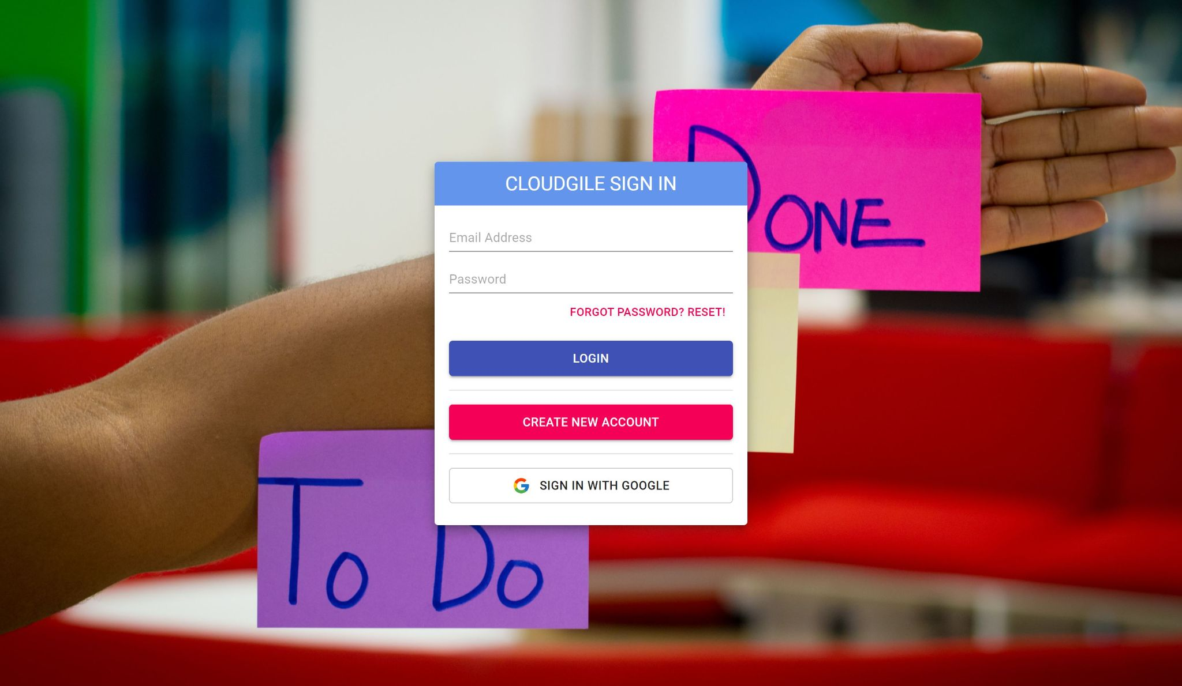
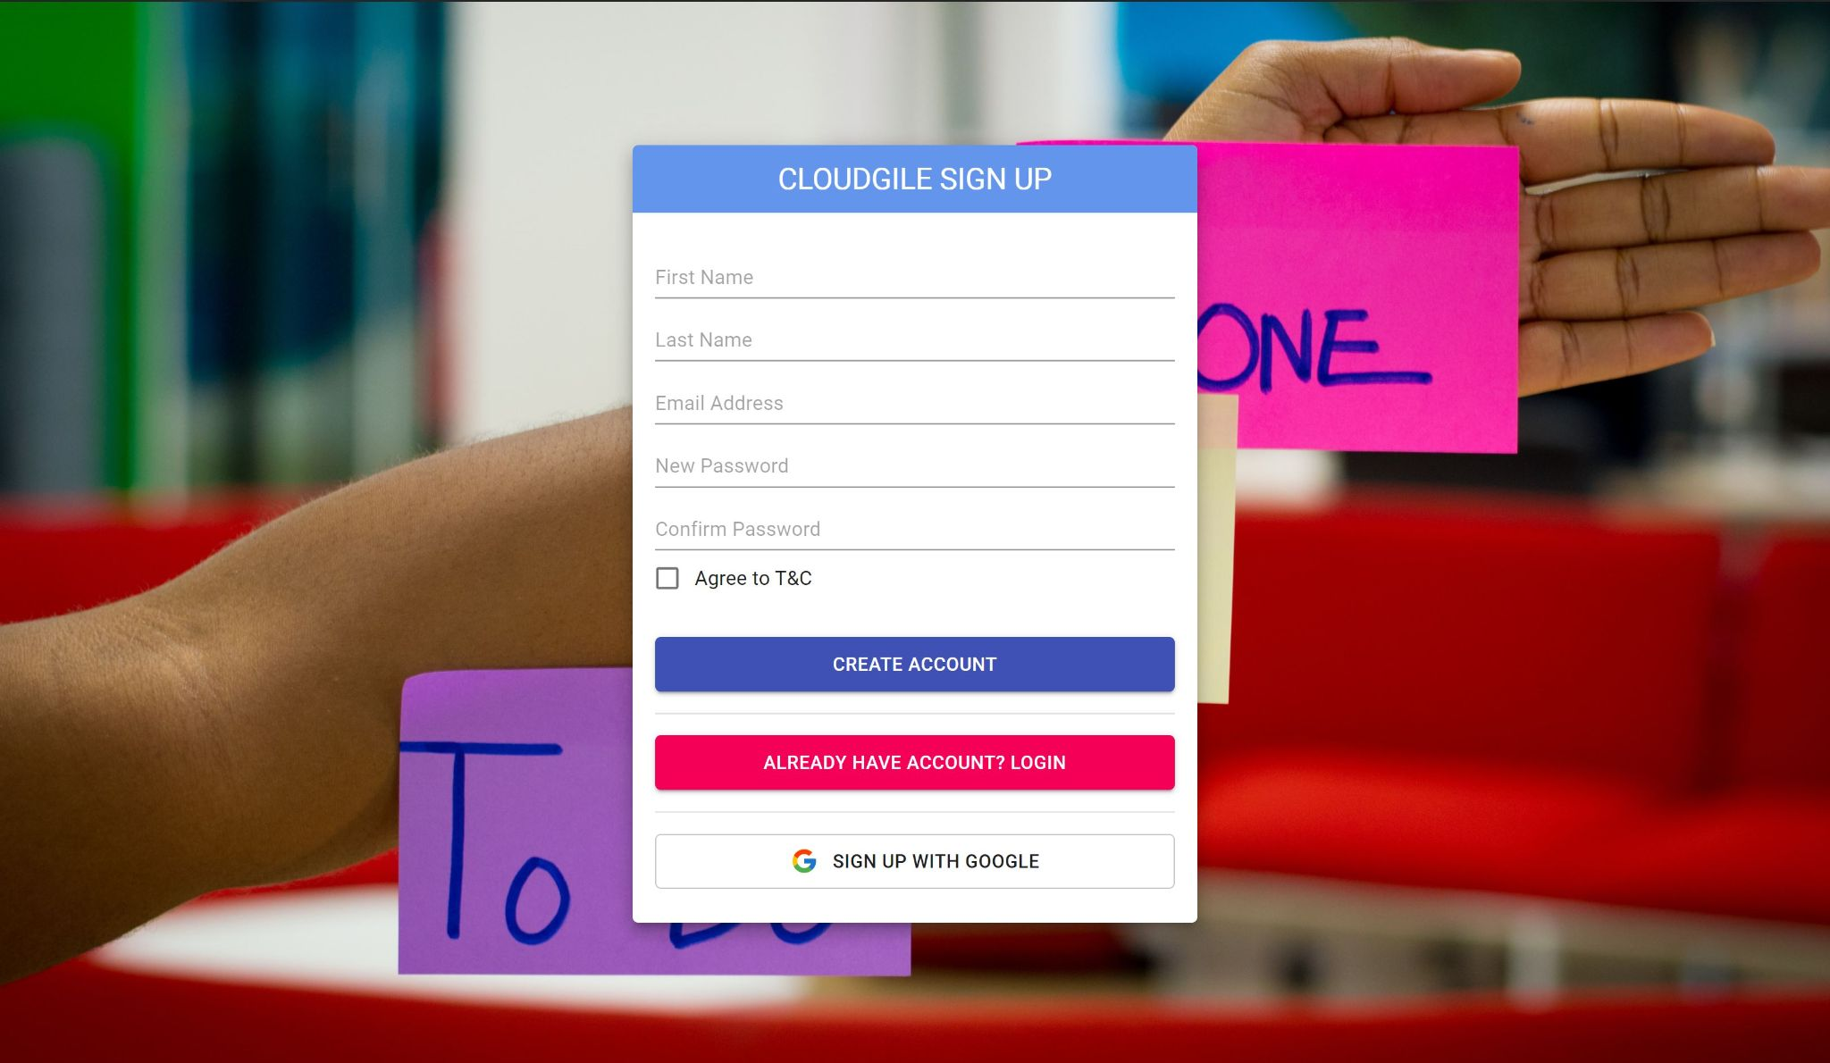

Slide 5
New User Tutorial
Whenever a new users Signs In, a product tutorial appears on the screen demonstrating basic functionality of the product such as creating a new project, changing the member settings, etc.
Using this feature makes it easy for the users to access different elements of the product in no time.
Although this feature can be skipped as per the users experience with such kind of industry knowledge.

Slide 6
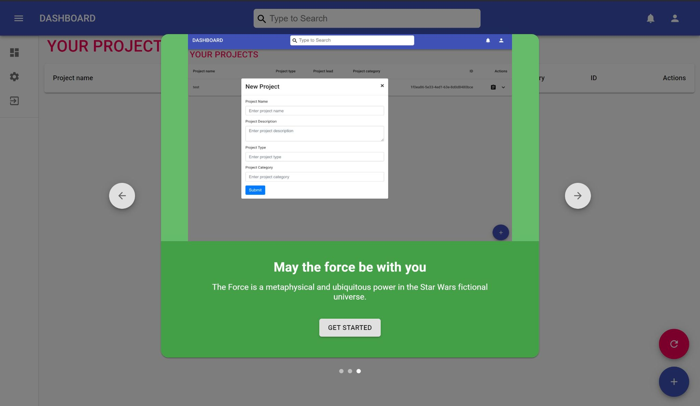

Slide 7
Product - Dashboard
Dashboard displays all the users existing projects as well as any new projects that the user creates by rendering all the information under projects section for each user from the Realtime Database.
The dashboard offers functionality to create a new project and to refresh the page for any existing project updates by using to circular buttons on the lower right corner.
Dashboard allows the users to change account settings such changing the username and password, deleting the account, updating the account link and security settings.

Slide 8
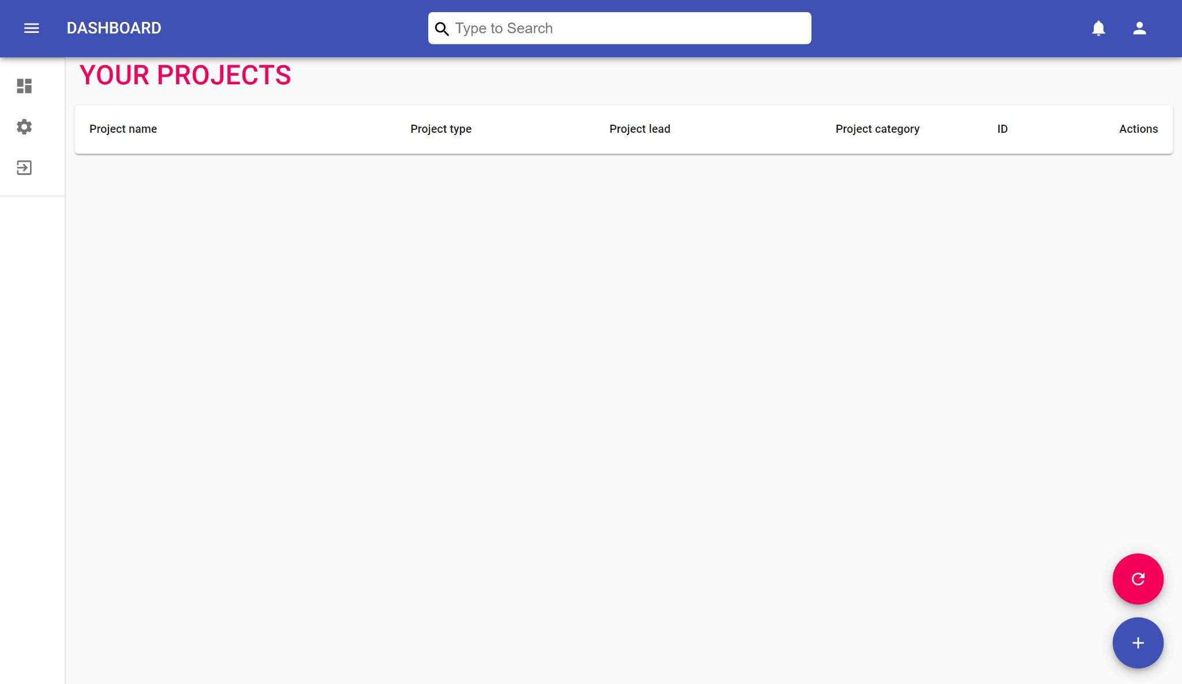

Slide 9
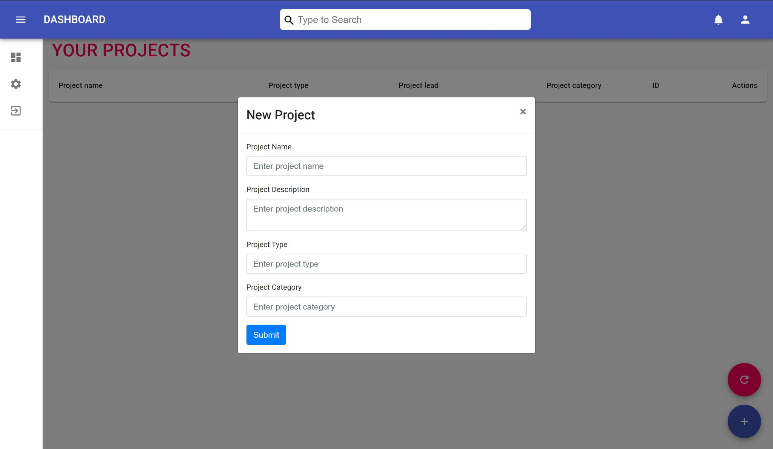
Dashboard - Creating a New Project
Dashboard has the functionality to create a new project and it displays all the existing project history with the latest updates on project “issue” by clicking the existing project dropdown.
All the fields in the project creation form are necessary to be implemented to determine the category of the project .

Slide 10
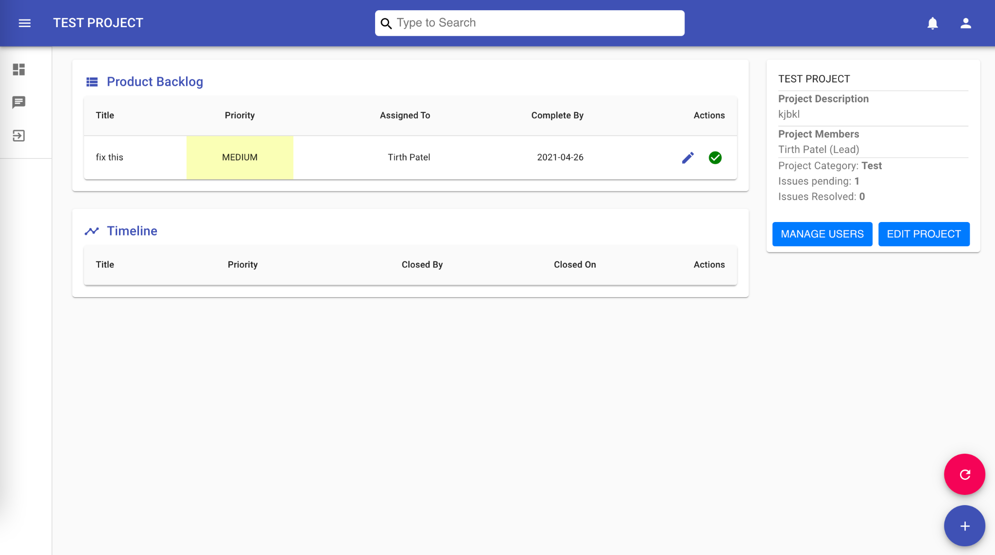
Project - Main Page/Project Dashboard
The project dashboard provides functionality to a view product backlog and timeline along with editing the project.
It provides functionality to manage (add/remove) users to/from the project .
Functionality to assign issue to different members is available.

Slide 11
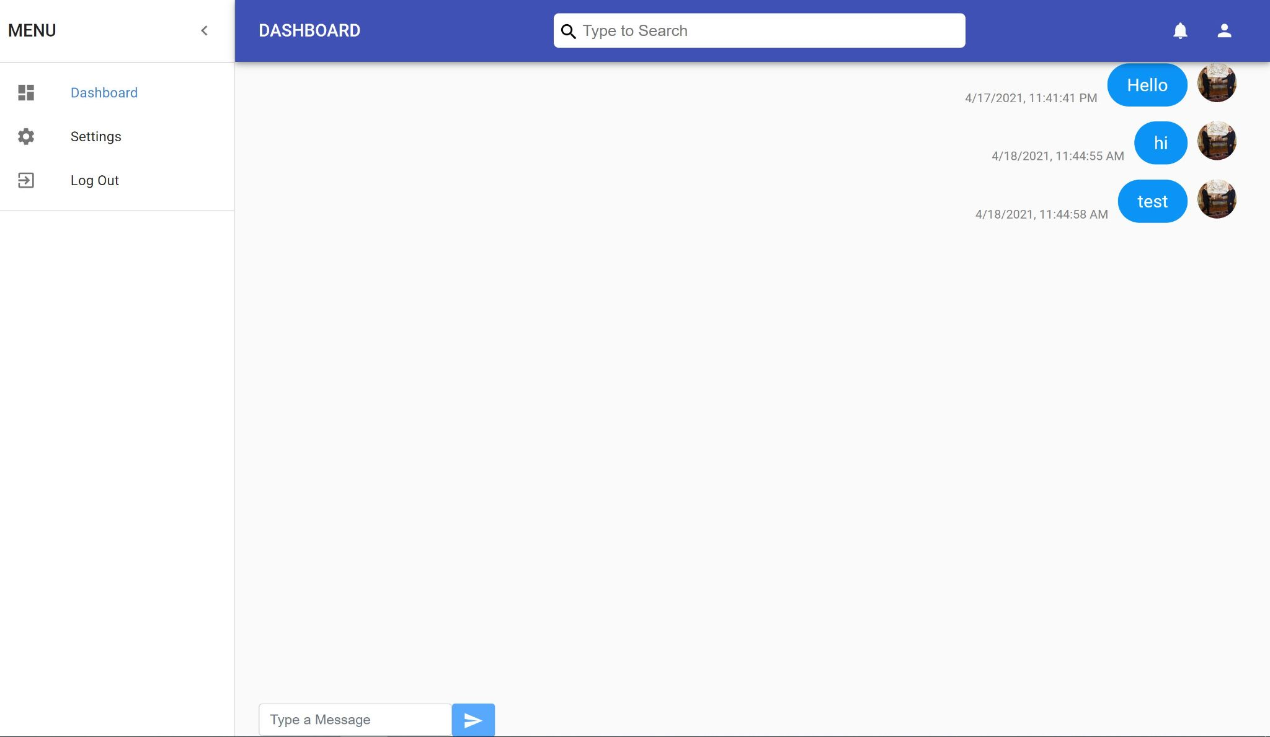
In App Chat
Cloudgile provides the functionality to chat with project members inside the application.

Slide 12
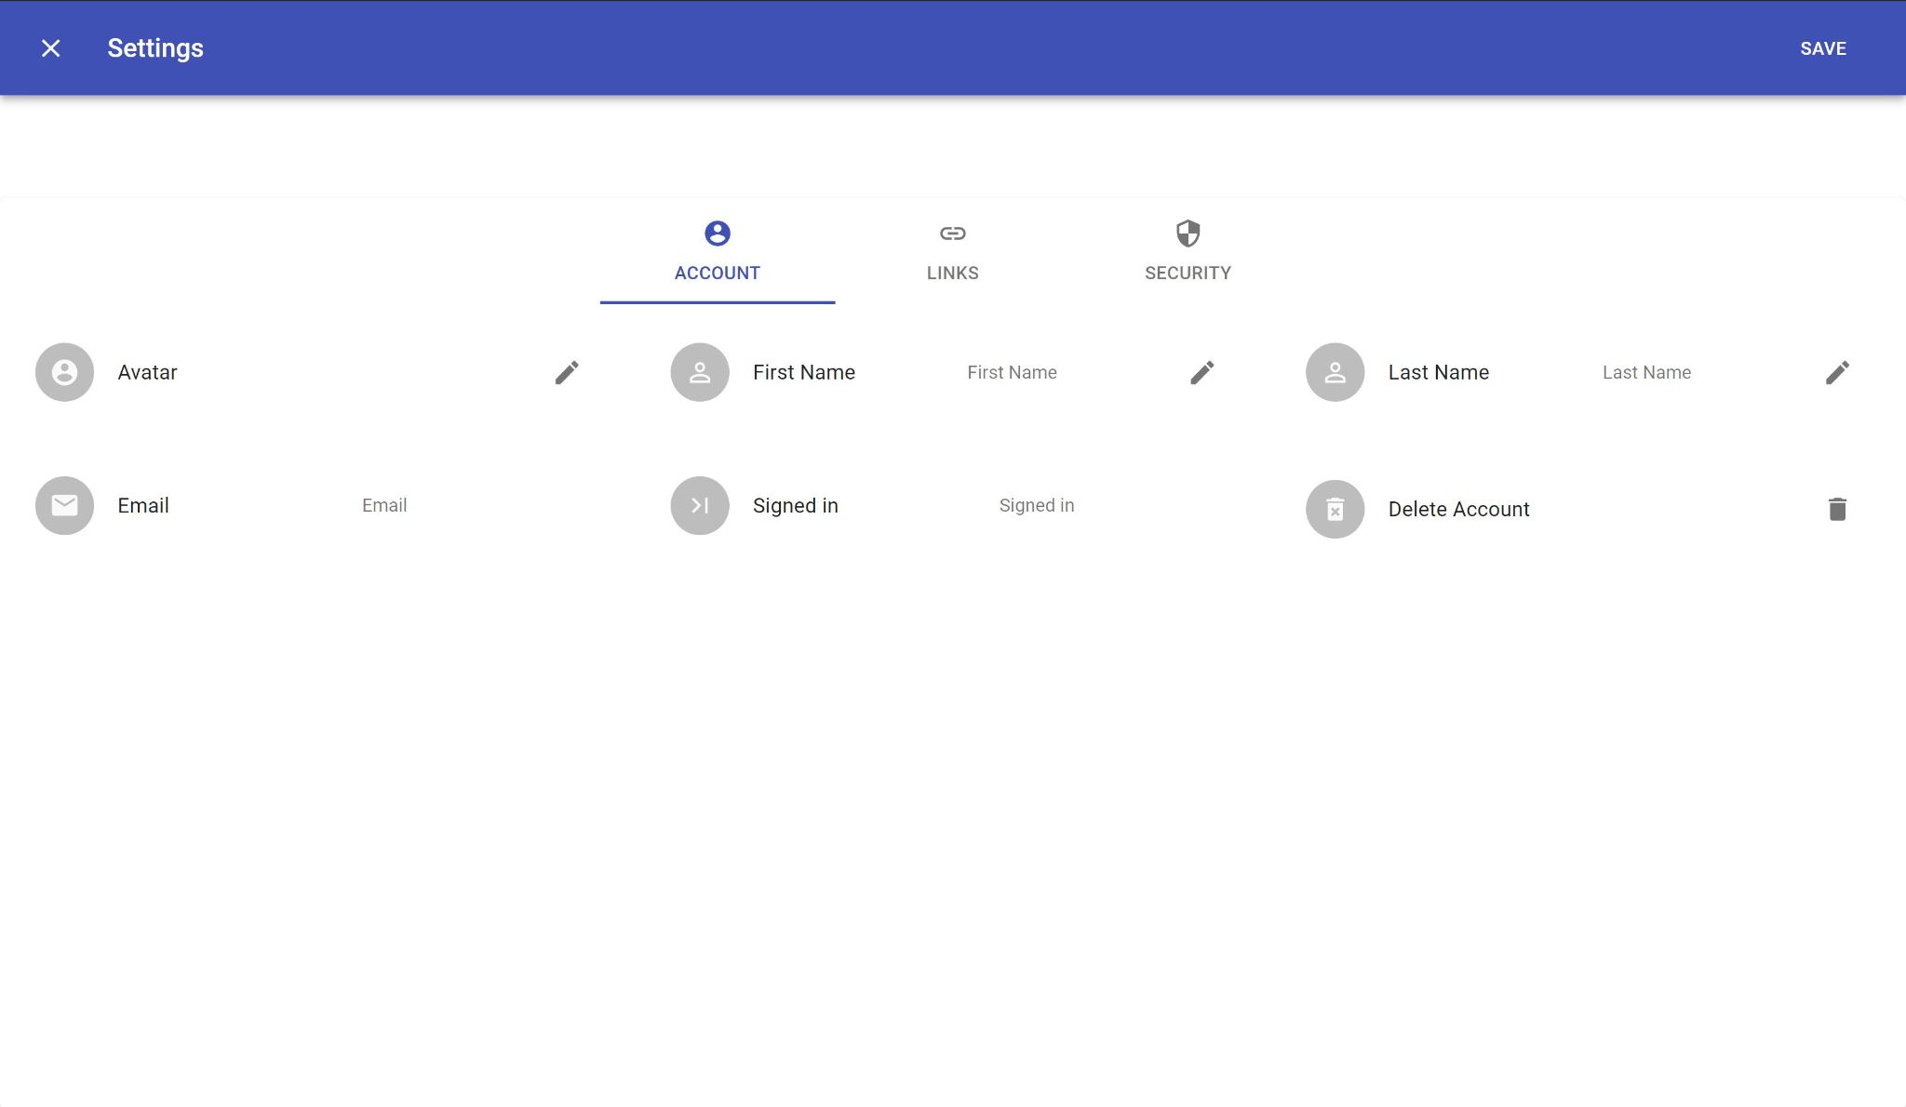
Settings Page
Users also have the ability to change their account settings.

Slide 13
Next Steps
Integrate Git with the project that allows version control directly from the application
The project should support video call, voice call and screen sharing between different members of a particular project.

